Slide 1
Customer Management Department
Here is where your data begins

Slide 2
Member Login
01
Dashboard
02
Corporate Details
Reference Details
CONTENTS
04
03
Passengers Menu
05
Invoice Menu
06
Admin & User
User Information update & password change
Insert Corporate Details against reference
Insert new reference
CRUD of Passengers
CRUD of Invoice

Slide 3
01
MEMBER LOGIN

Slide 4
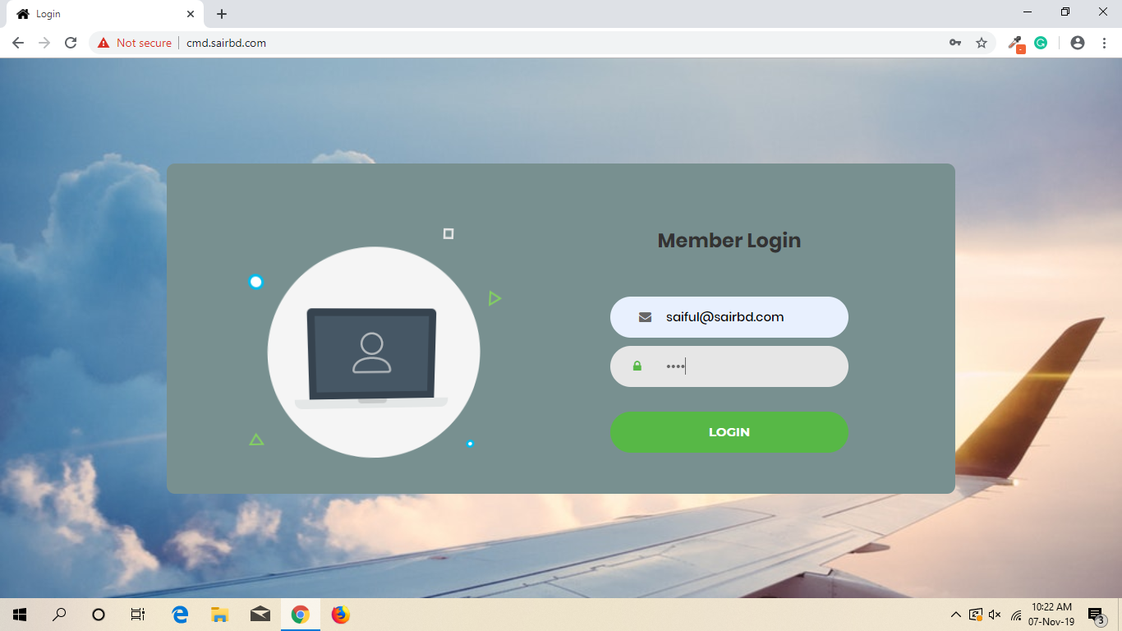

Slide 5
02
DASHBOARD

Slide 6
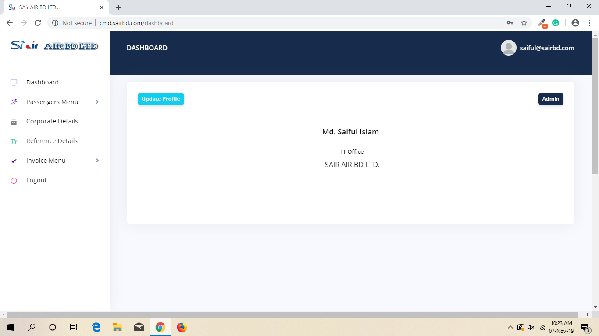
Dashboard

Slide 7
Dashboard

Slide 8
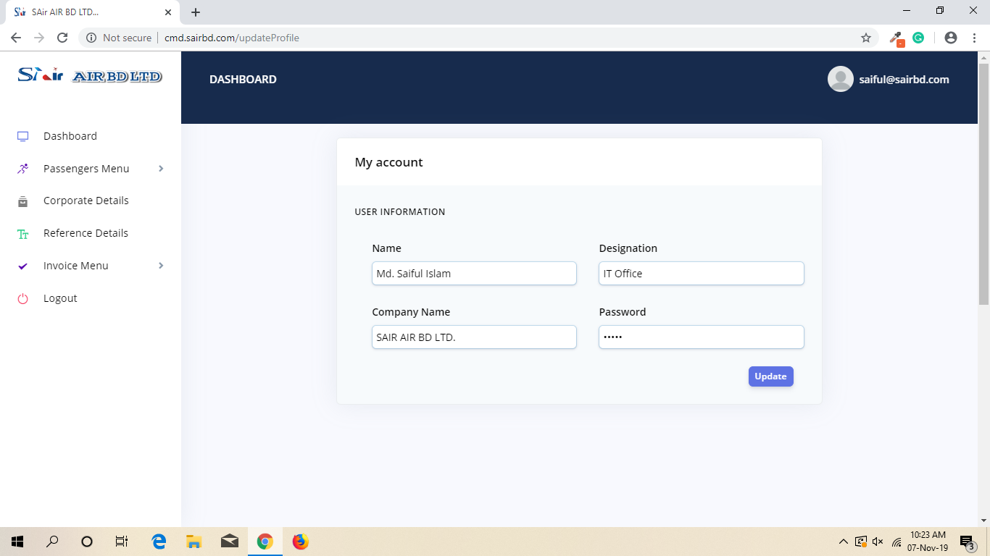
Update User Info

Slide 9
03
REFERENCE DETAILS

Slide 10
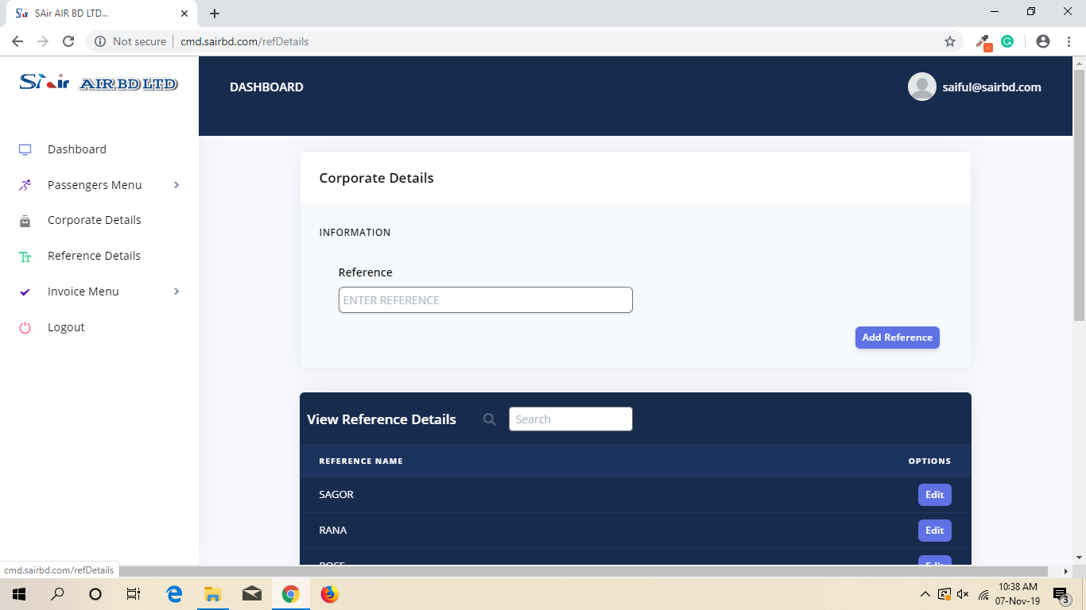
Add New Reference

Slide 11
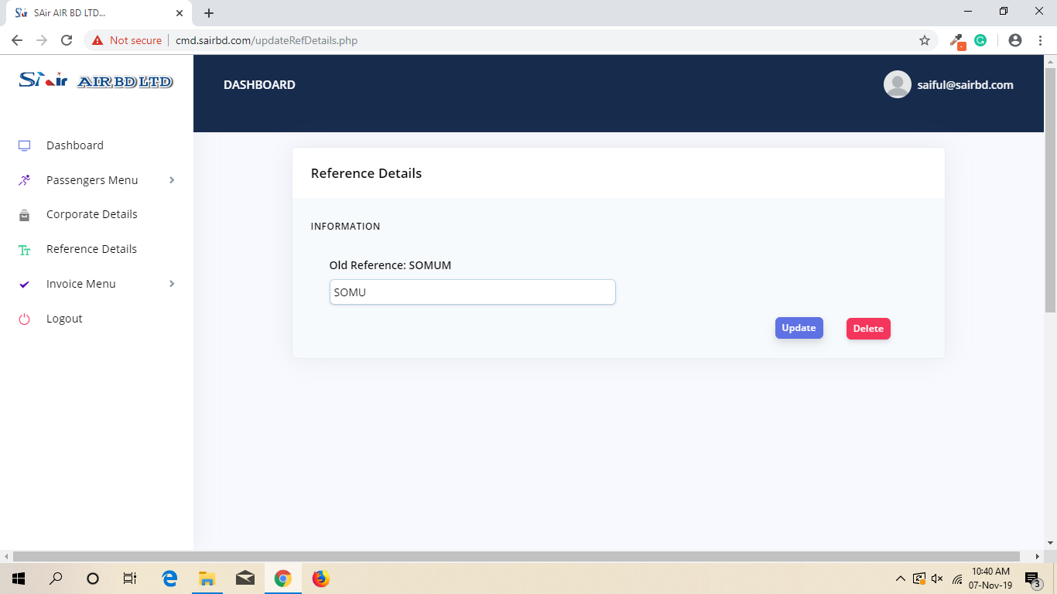
U/D Old Reference

Slide 12
04
CORPORATE DETAILS

Slide 13
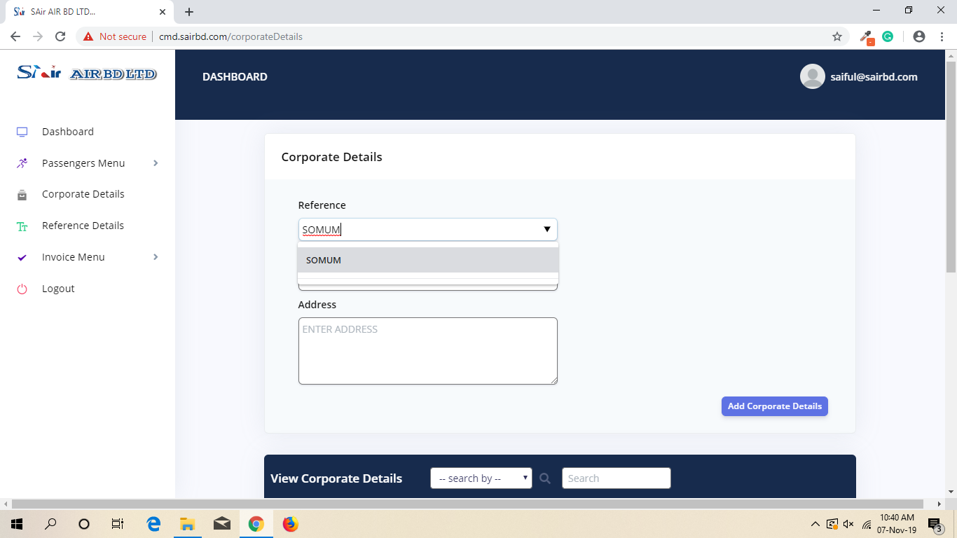
Add Corporate details

Slide 14
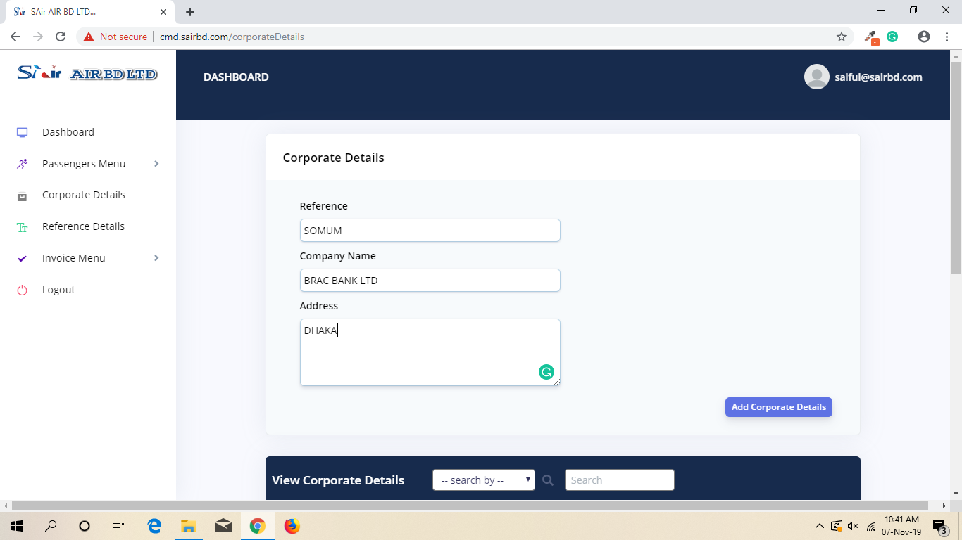
Add Corporate details

Slide 15
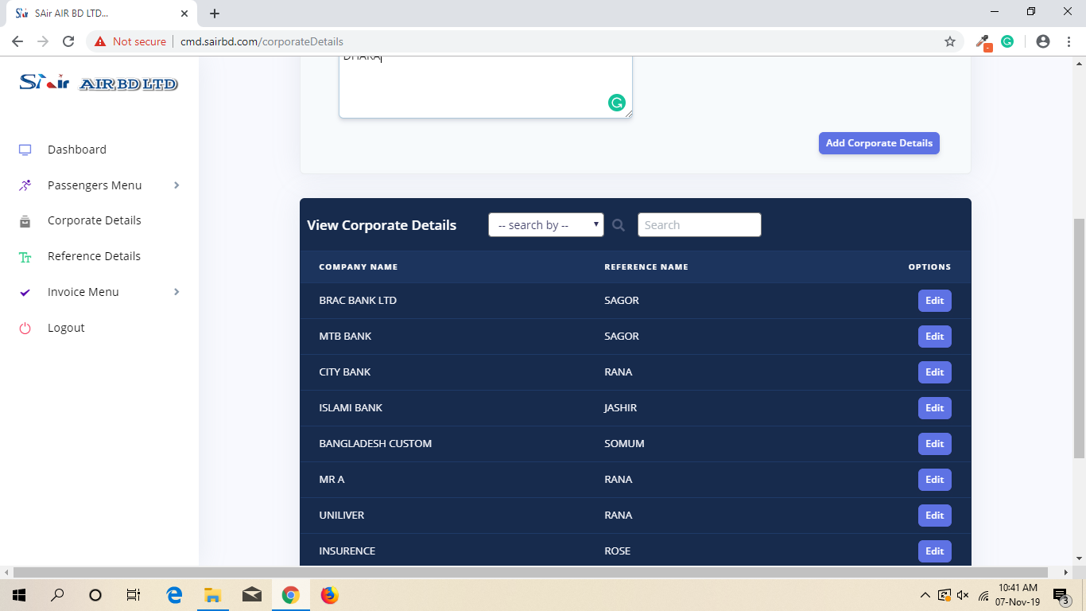
View Corporate details

Slide 16
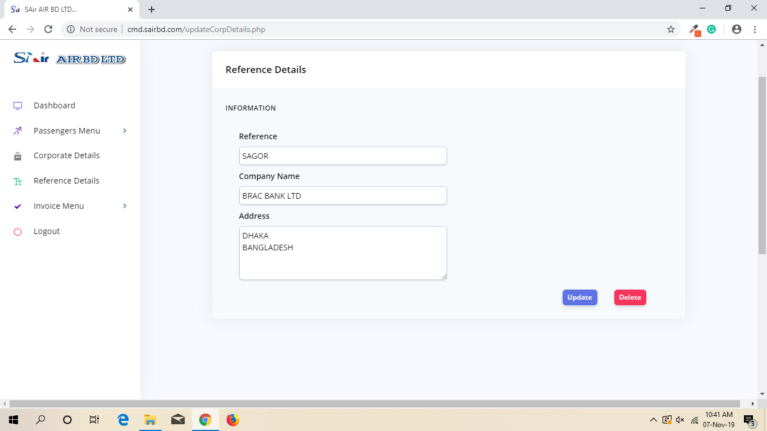
U/D Corporate details

Slide 17
05
PASSANGERS MENU

Slide 18
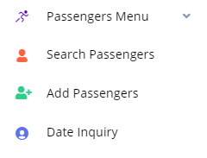
IN DEPTH
Add Passengers
Date Inquiry
5.1
5.2
Search Passengers
5.3

Slide 19
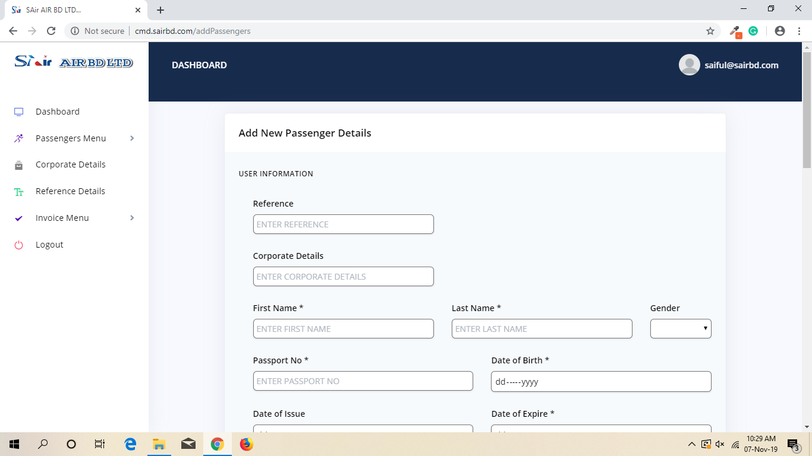
Add Passengers
(must)

Slide 20
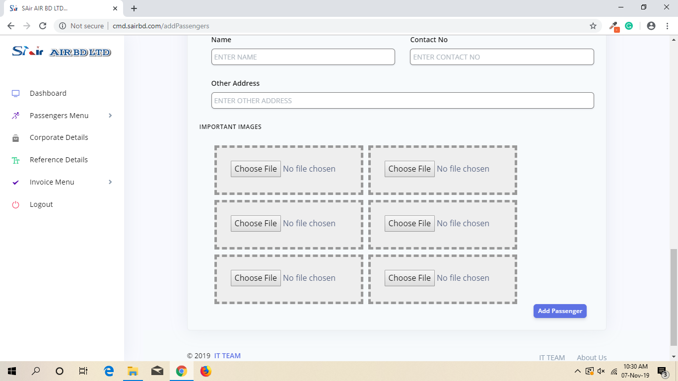
Add Passengers
(any format)

Slide 21
Add Passengers

Slide 22
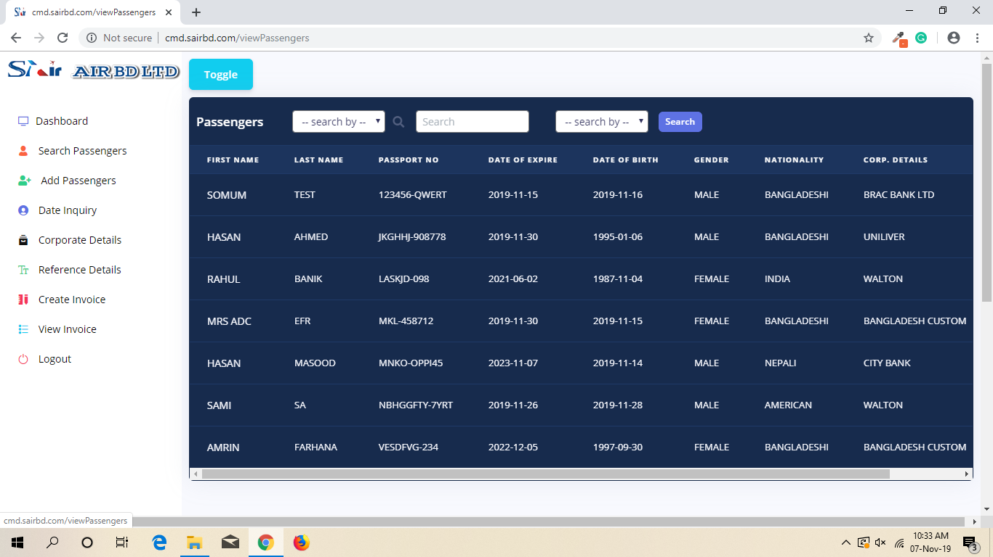
Search Passengers

Slide 23
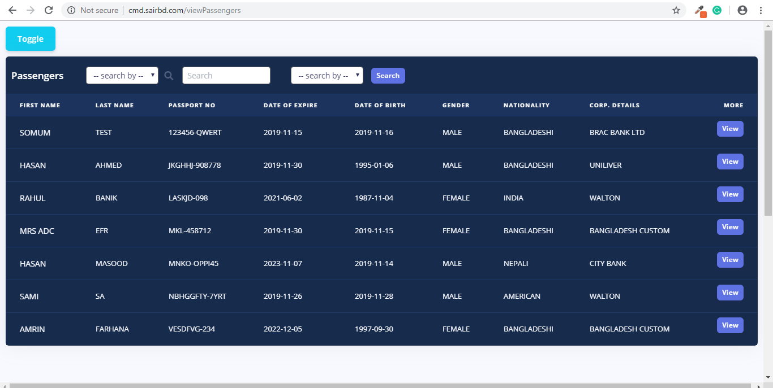
Search Passengers

Slide 24
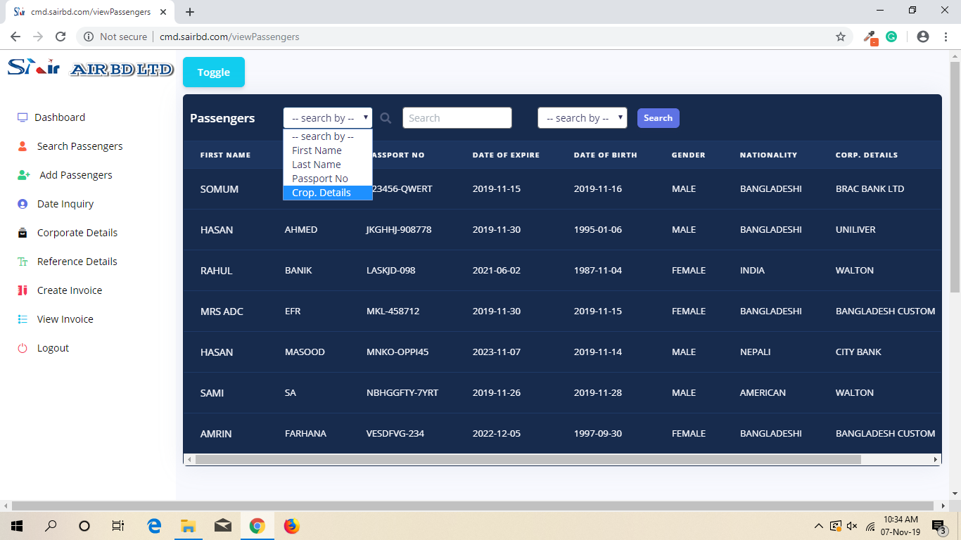
Search Passengers

Slide 25
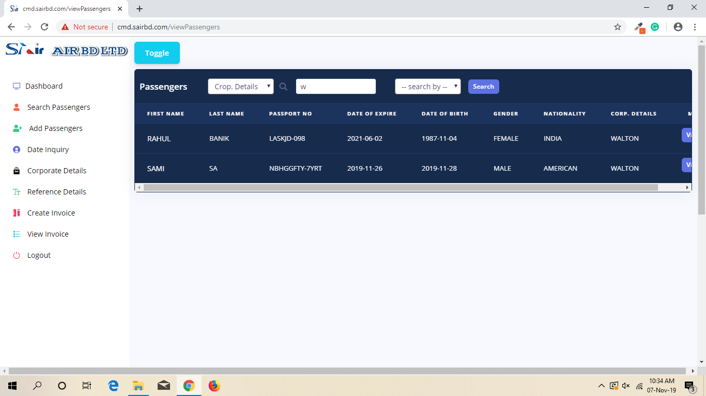
Search Passengers

Slide 26
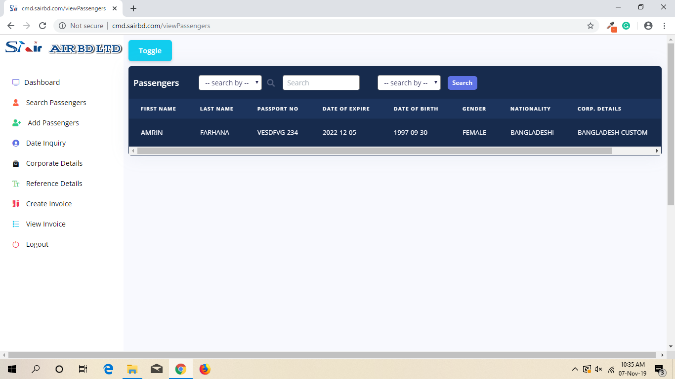
Search Passengers
DOB(Month)

Slide 27
Search Passengers

Slide 28
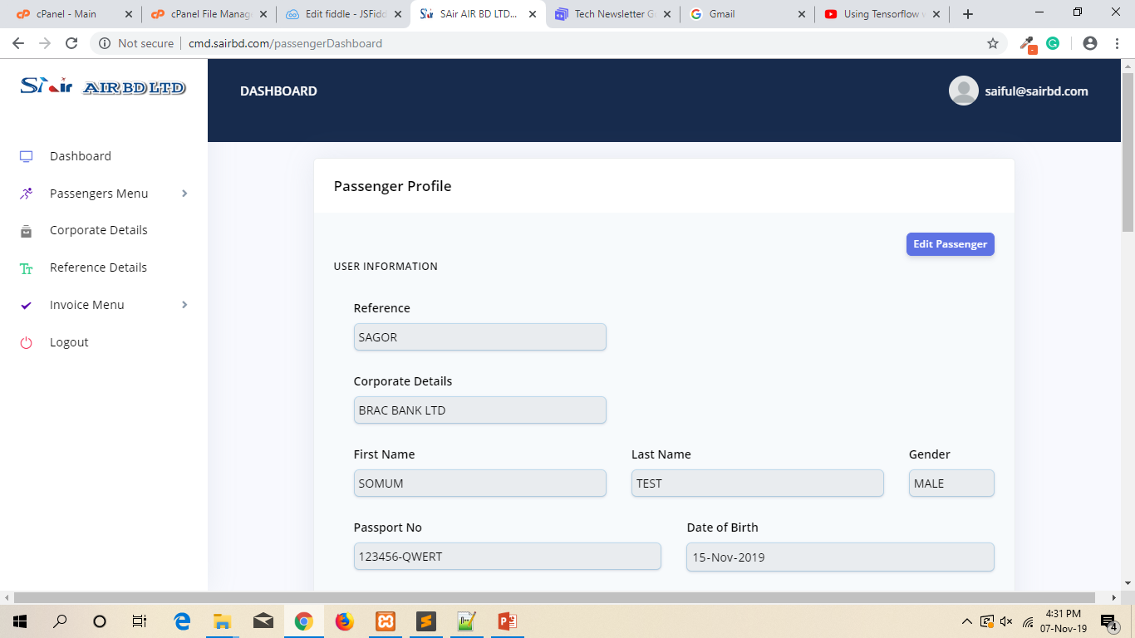
View Passengers

Slide 29
Edit Passenger

Slide 30
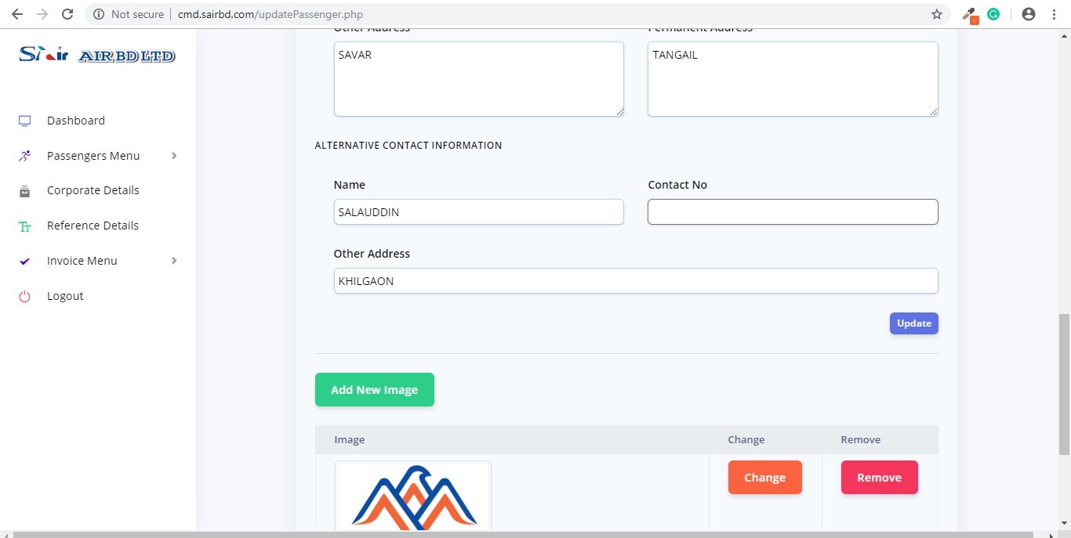
Update Passenger

Slide 31
06
INVOICE MENU

Slide 32

IN DEPTH
Create
Invoice
Invoice Menu
View Invoice
Office Invoice

Slide 33
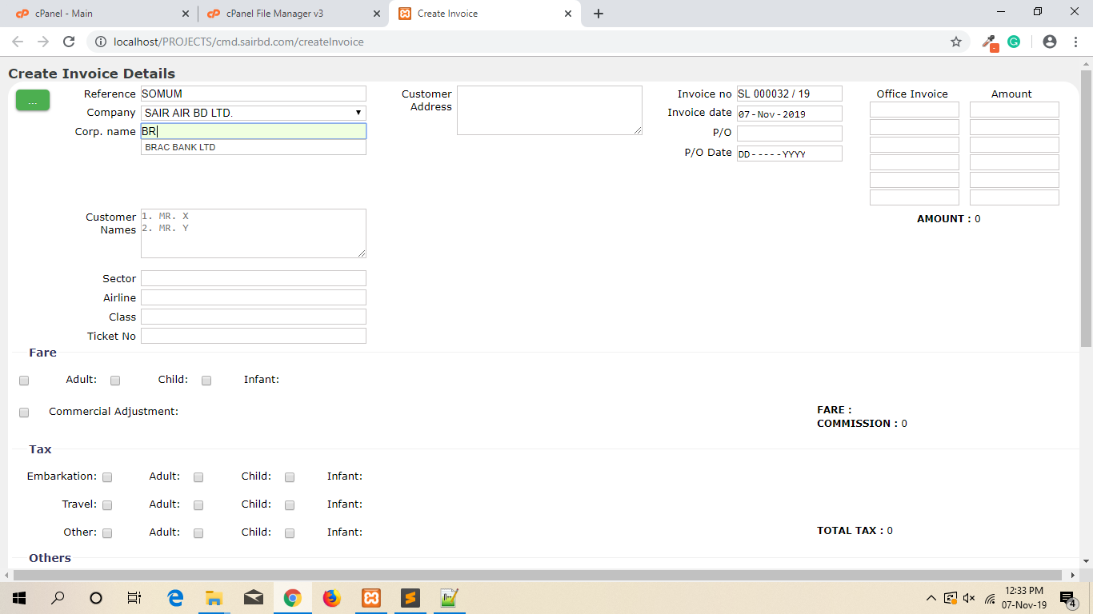
Create Invoice

Slide 34
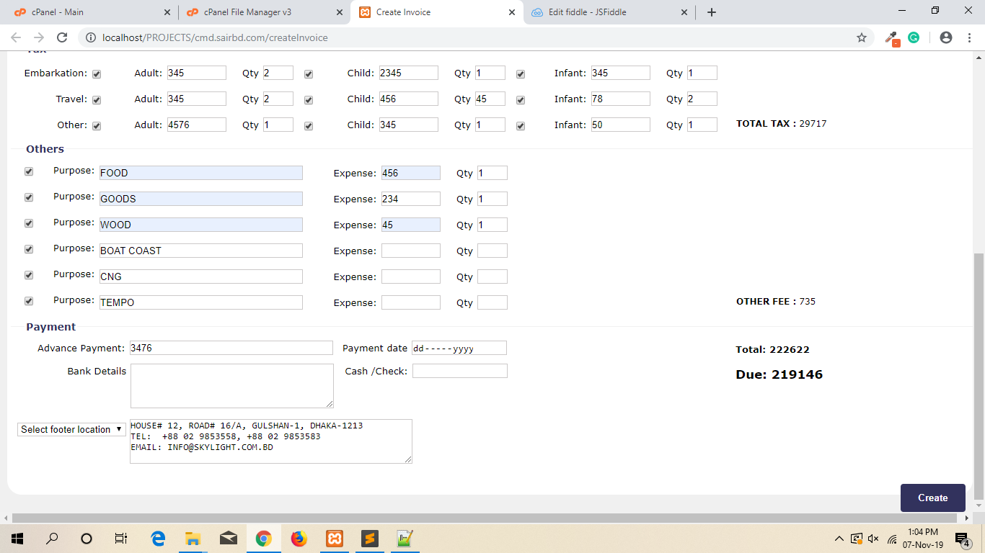
Create Invoice

Slide 35
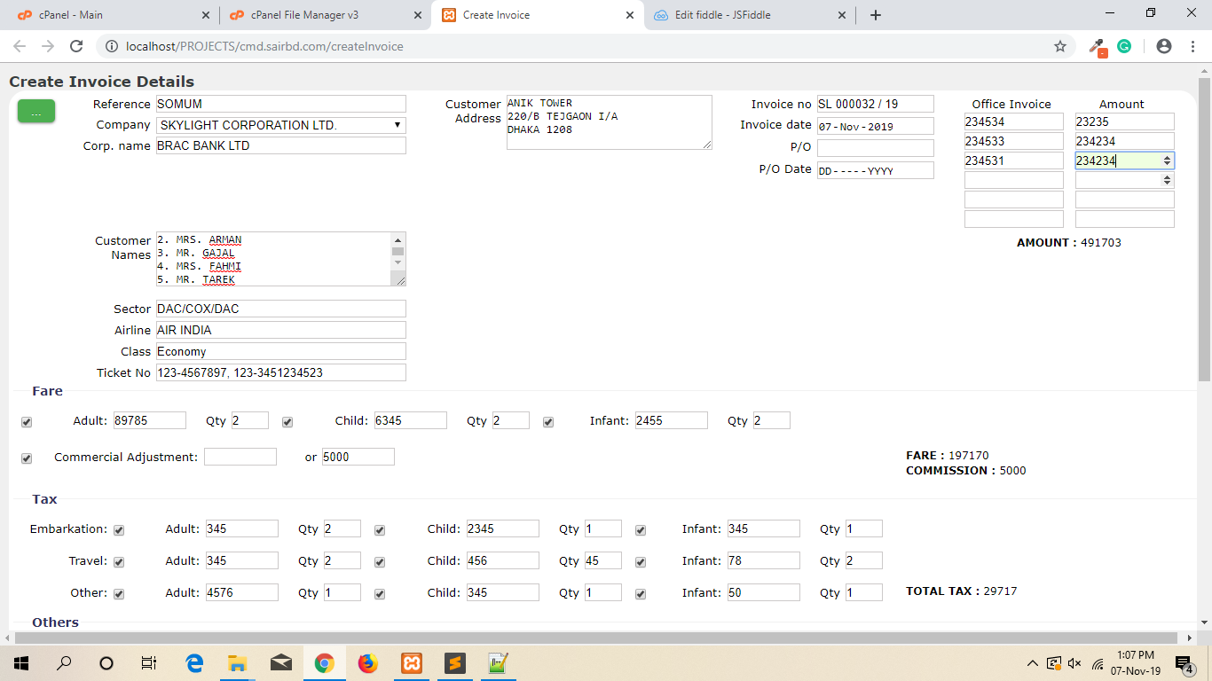
Create Invoice

Slide 36
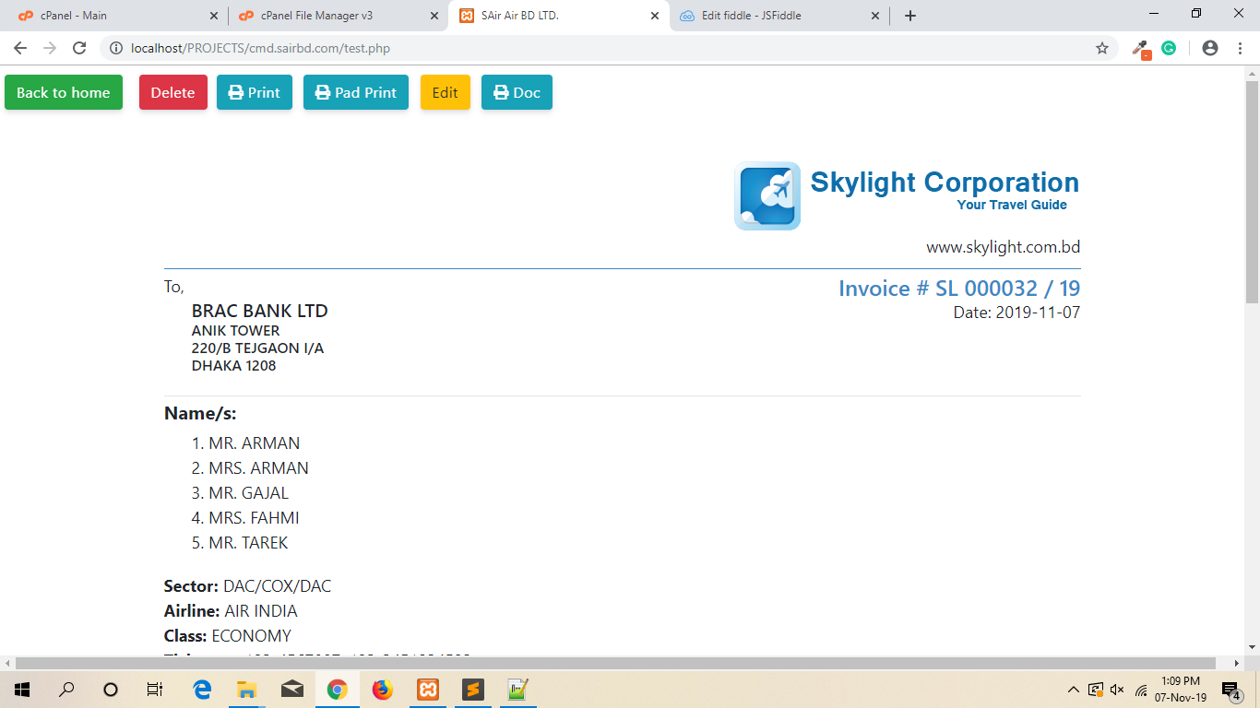
View Invoice

Slide 37
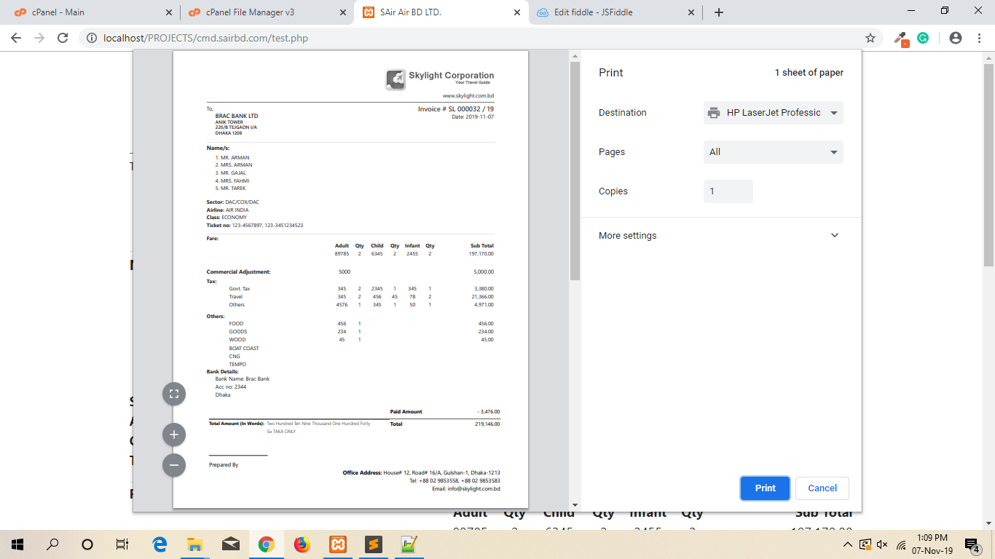
View Invoice
Normal print

Slide 38
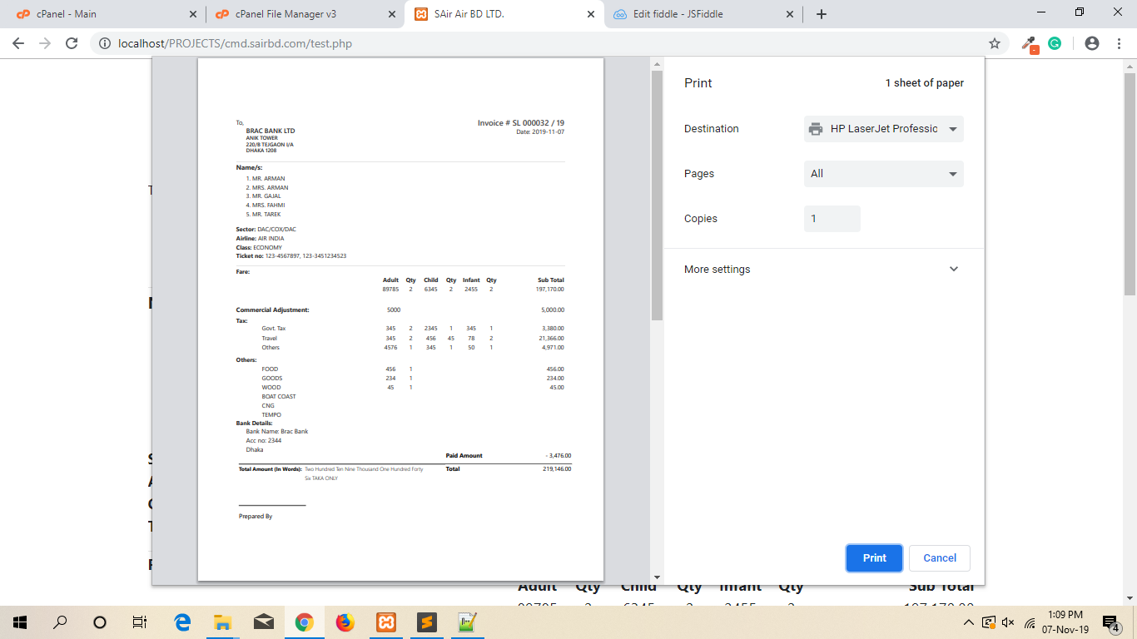
View Invoice
Pad print

Slide 39
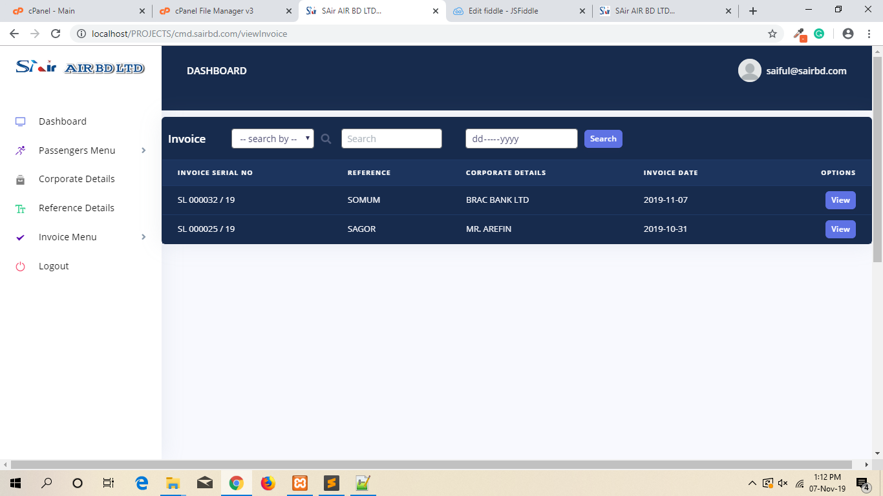
View Invoice

Slide 40
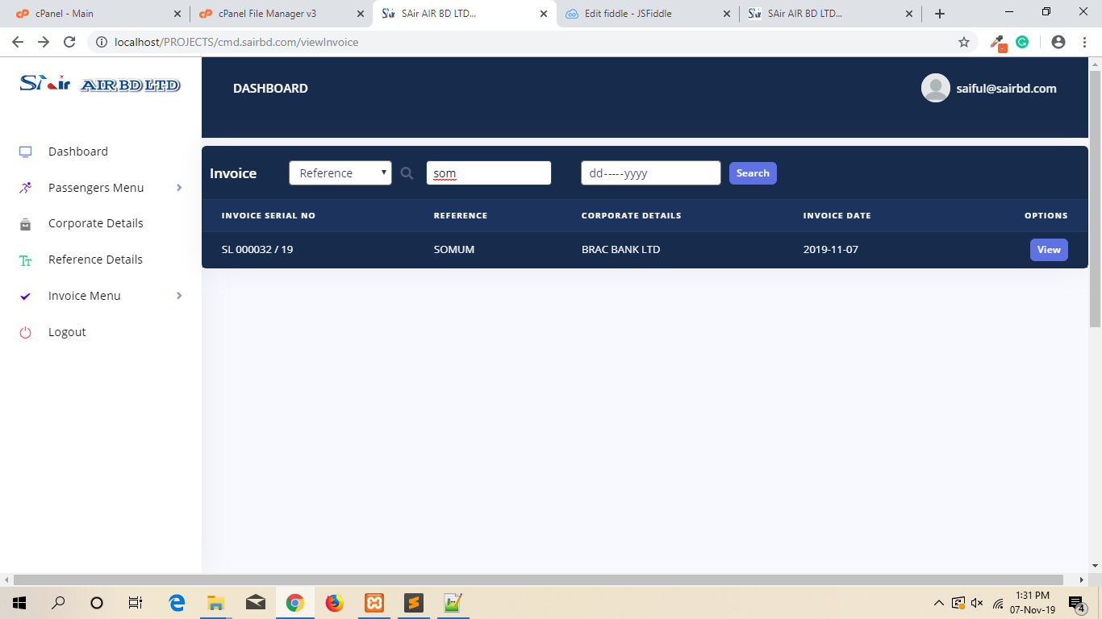
View Invoice

Slide 41

View Invoice

Slide 42
View Invoice

Slide 43
Edit Invoice

Slide 44
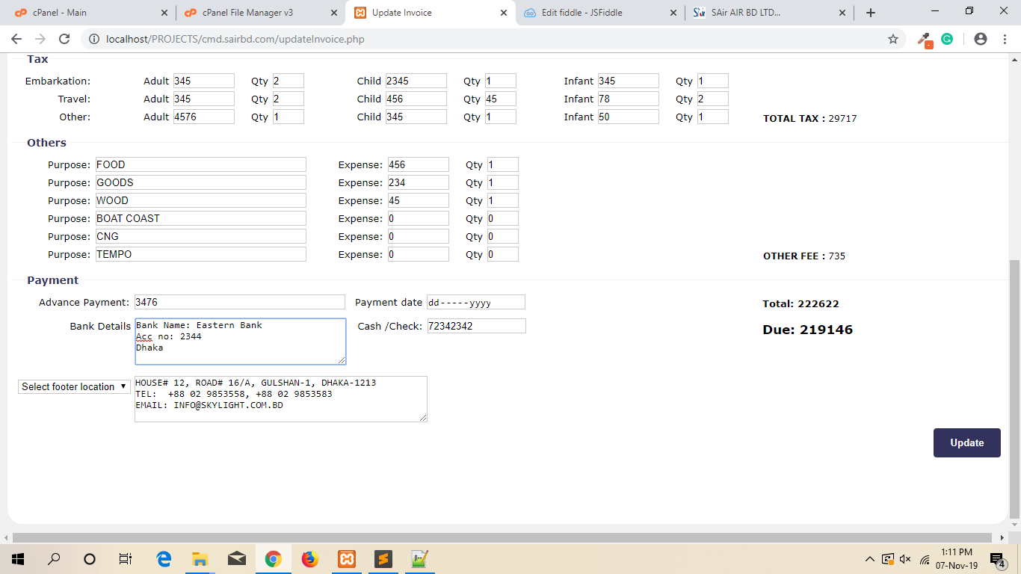
Edit Invoice

Slide 45
Last Topic
Office Invoice

Slide 46
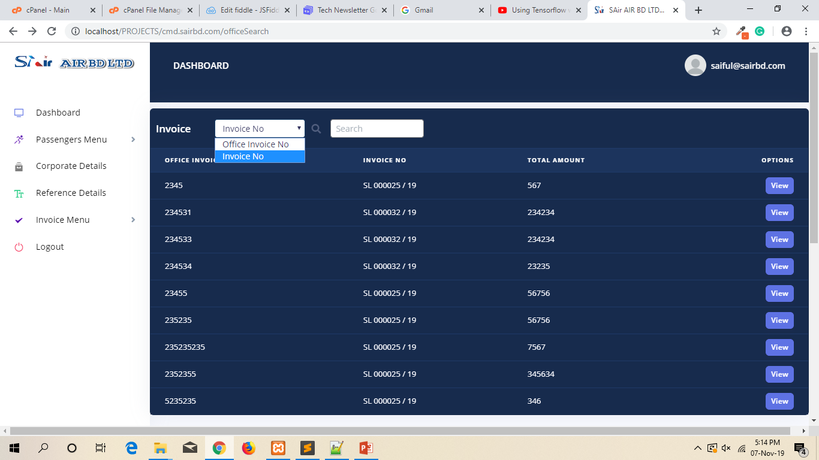
Office Invoice

Slide 47
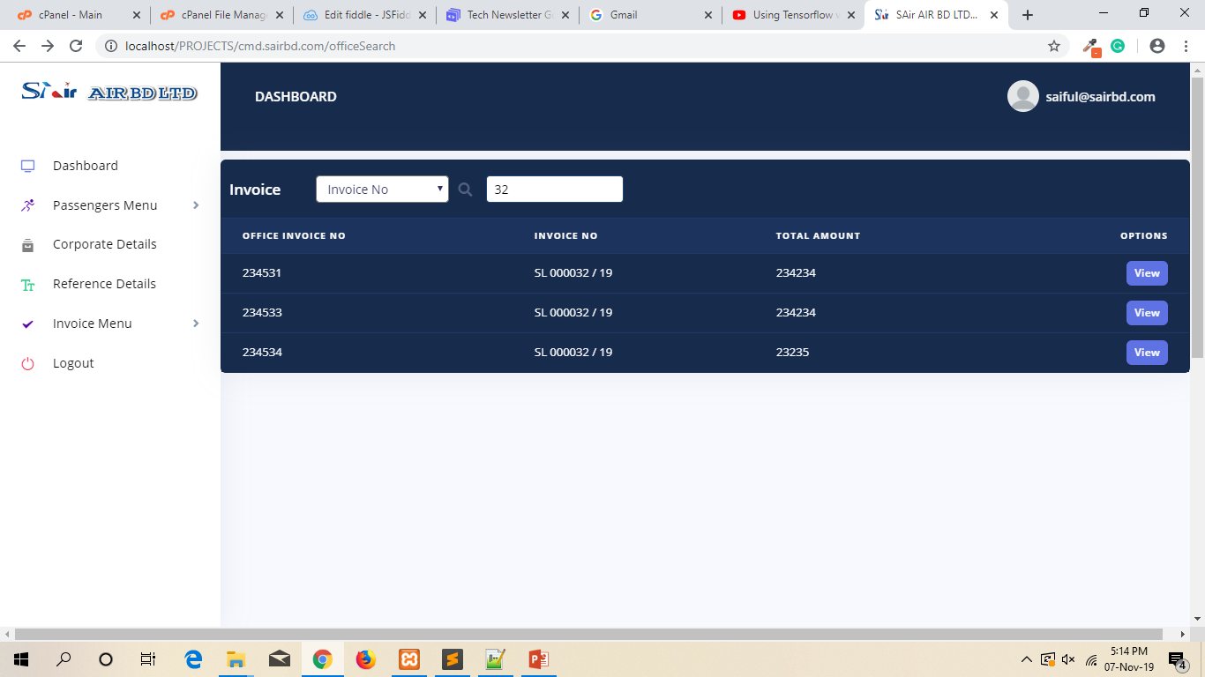
Office Invoice

Slide 48
THANK YOU

